Slide 1
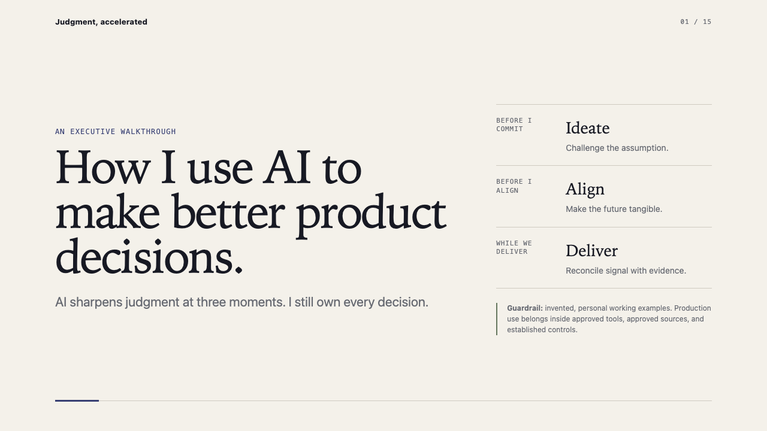
Notes:
Open with the operating idea: AI sharpens judgment at three moments, while the leader retains ownership.
[Sources]
- Internal illustrative material from the AI Demo package.

Slide 2
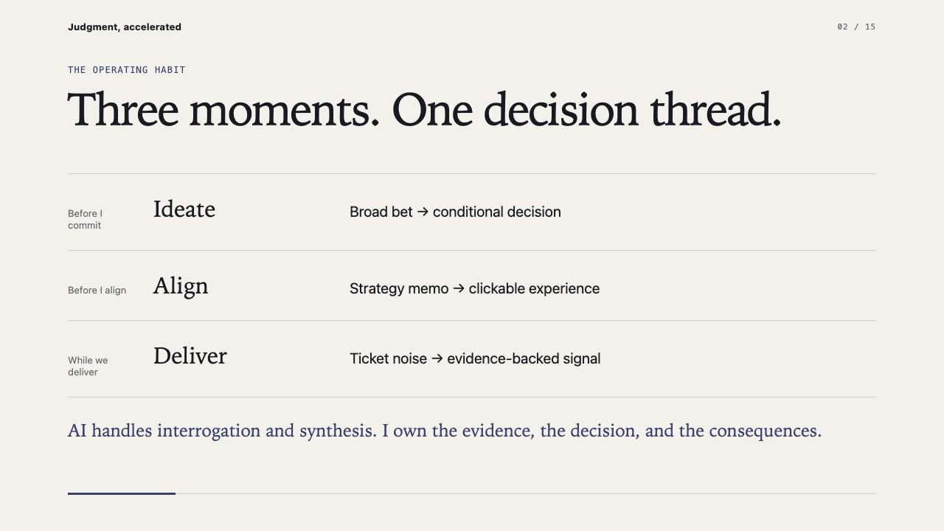
Notes:
Establish the full arc before going into the examples.
[Sources]
- Internal illustrative material from the AI Demo package.

Slide 3
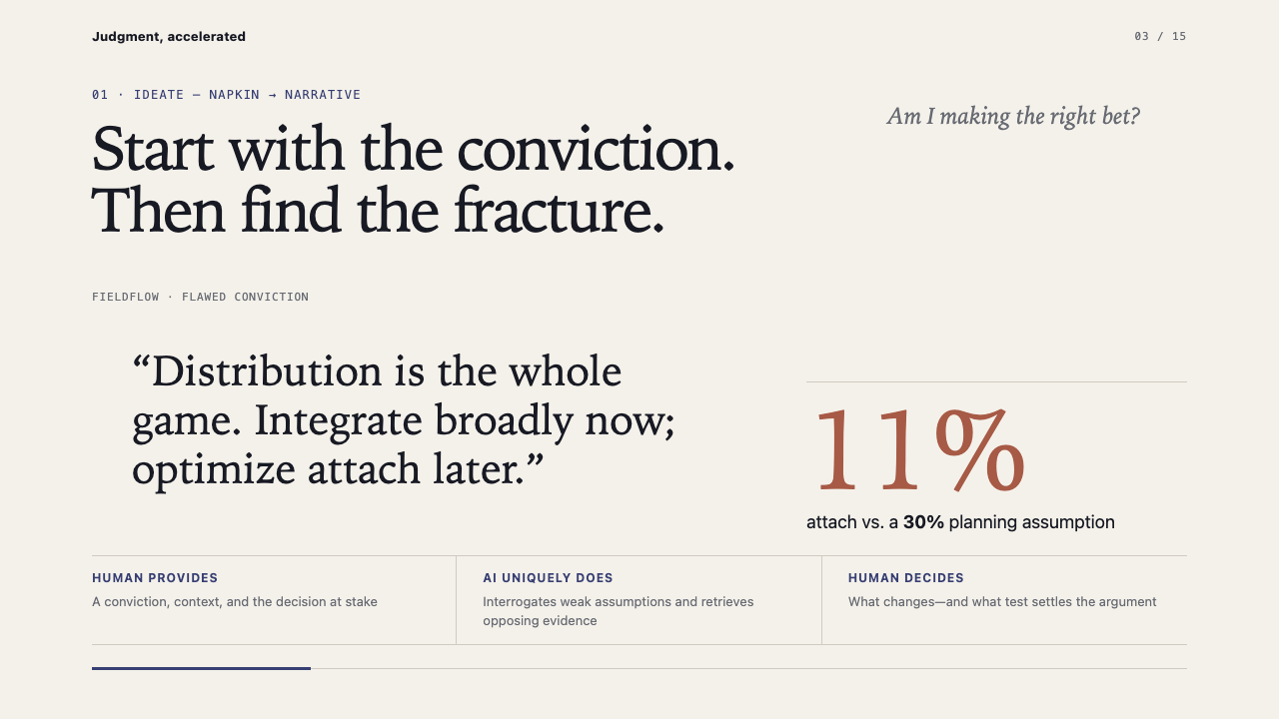
Notes:
The 11 percent attach rate is fictional. Use it to show why a confident slogan must become a testable bet.
[Sources]
- Internal invented FieldFlow example from the AI Demo package.

Slide 4
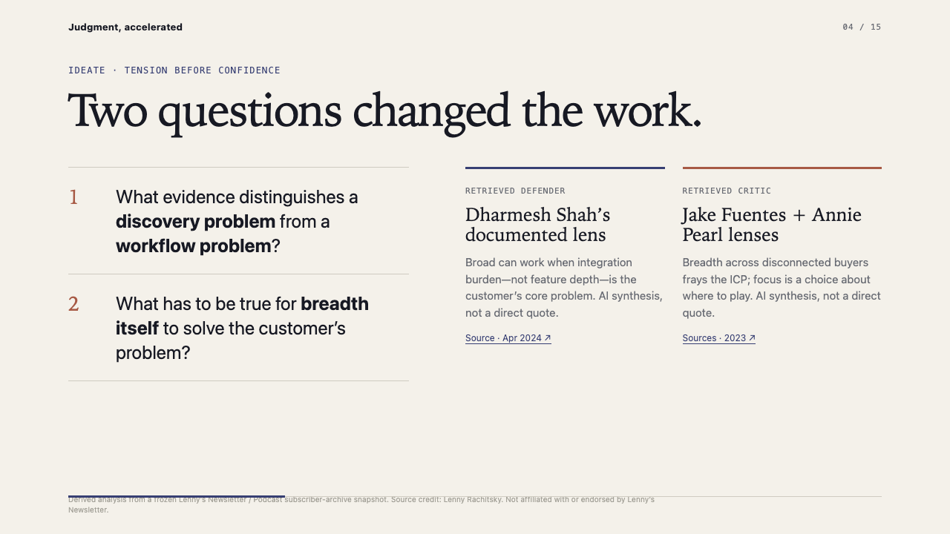
Notes:
The named viewpoints are AI syntheses of documented source material, not direct quotations.
[Sources]
- https://www.lennysnewsletter.com/p/lessons-from-30-years-of-building
- https://www.lennysnewsletter.com/p/lessons-learned-from-a-startup-that

Slide 5
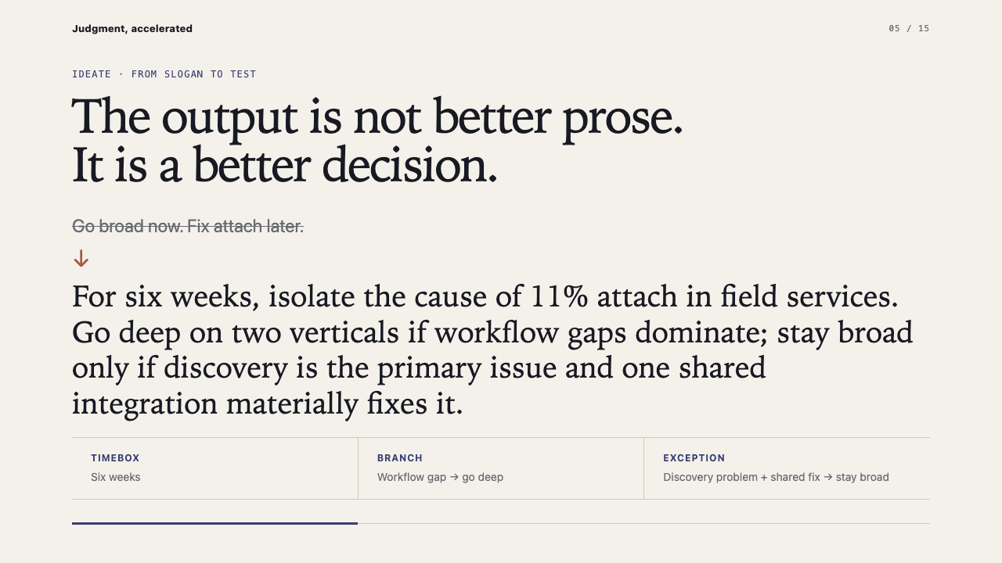
Notes:
Pause on the branches: timebox, workflow-driven focus, and the narrow condition that would justify staying broad.
[Sources]
- Internal invented FieldFlow example from the AI Demo package.
- https://www.lennysnewsletter.com/p/lessons-from-30-years-of-building
- https://www.lennysnewsletter.com/p/lessons-learned-from-a-startup-that

Slide 6
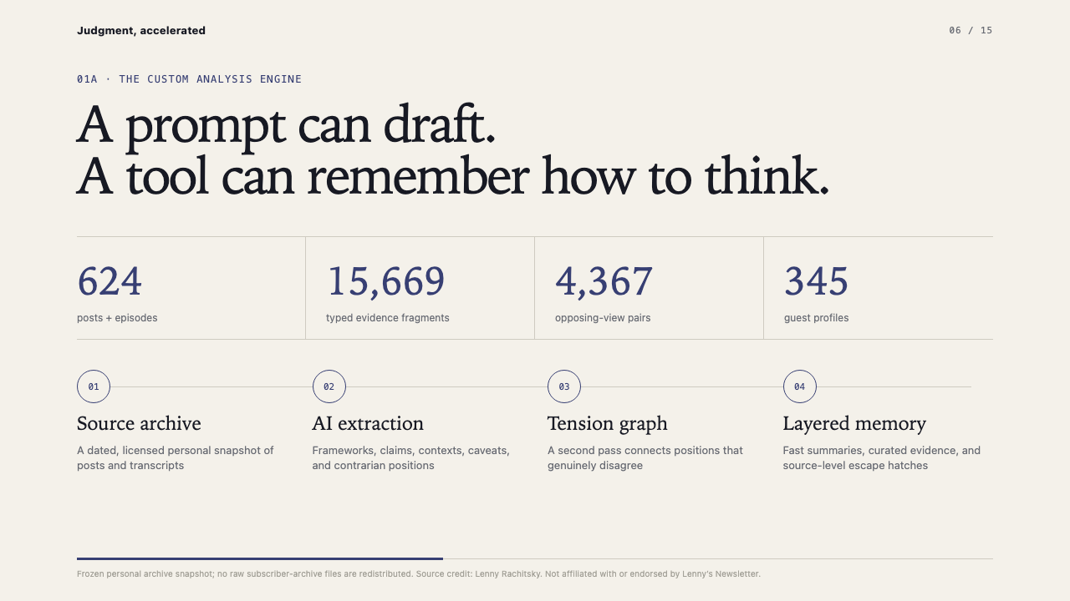
Notes:
These counts describe a frozen personal snapshot. No raw subscriber archive is included or redistributed.
[Sources]
- https://www.lennysnewsletter.com/

Slide 7
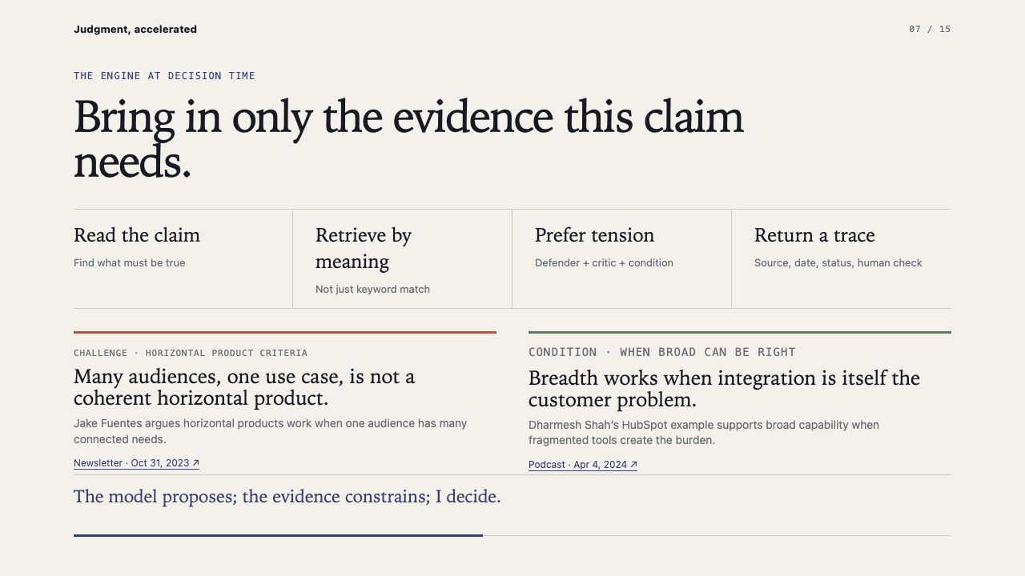
Notes:
Emphasize retrieval by meaning, preference for real tension, and source-level traceability.
[Sources]
- https://www.lennysnewsletter.com/p/lessons-from-30-years-of-building
- https://www.lennysnewsletter.com/p/lessons-learned-from-a-startup-that

Slide 8
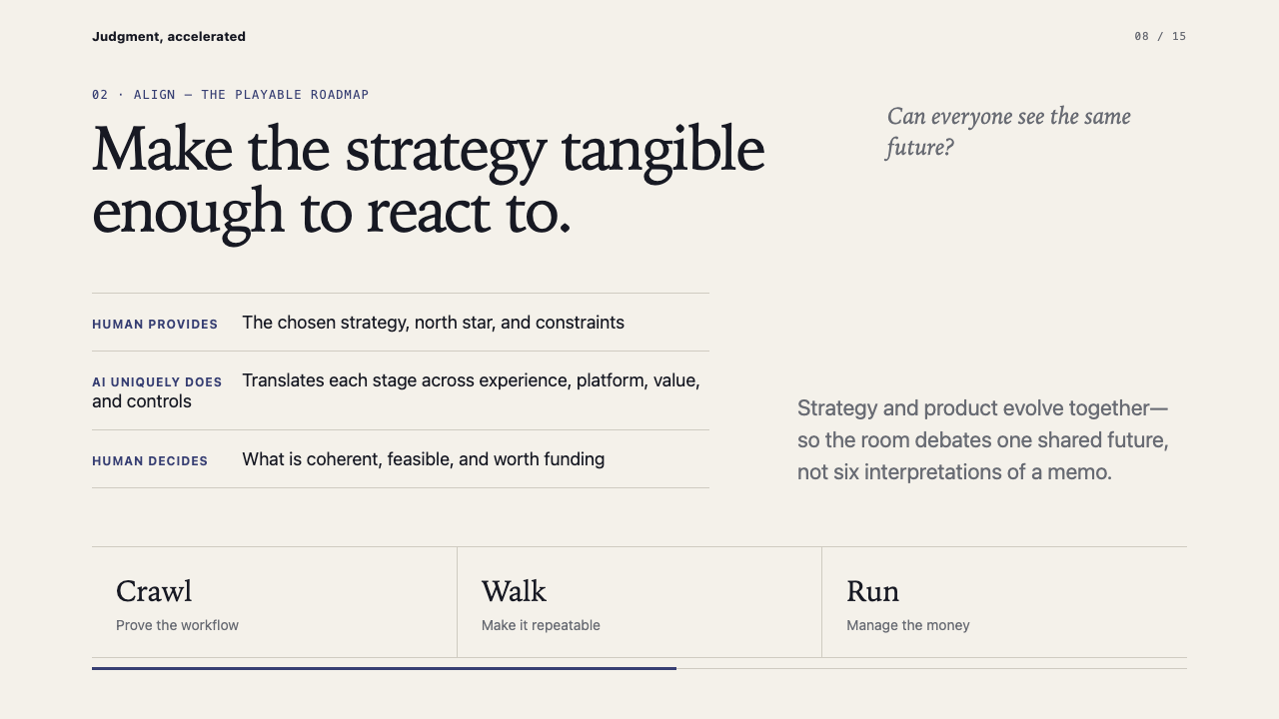
Notes:
The playable roadmap gives the room one shared object to critique across experience, platform, value, and controls.
[Sources]
- Internal invented FieldFlow and Northside HVAC examples from the AI Demo package.

Slide 9
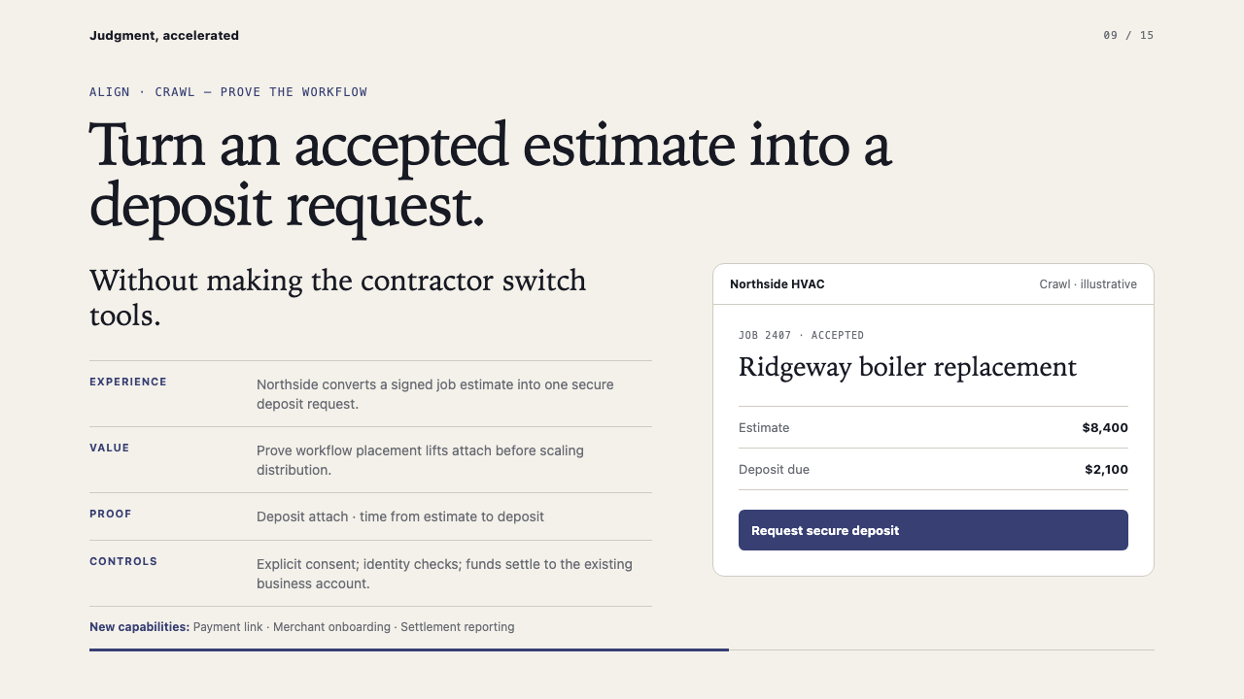
Notes:
Crawl tests whether payment inside the field-service workflow changes attach before scaling distribution.
[Sources]
- Internal invented FieldFlow and Northside HVAC examples from the AI Demo package.

Slide 10
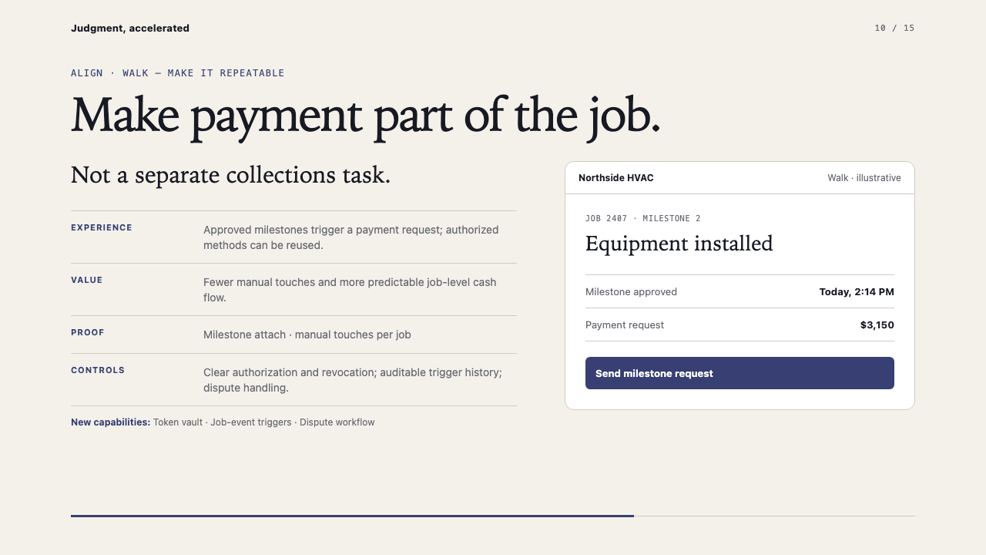
Notes:
Walk adds repeatability and the controls needed for authorized milestone-triggered payment requests.
[Sources]
- Internal invented FieldFlow and Northside HVAC examples from the AI Demo package.

Slide 11
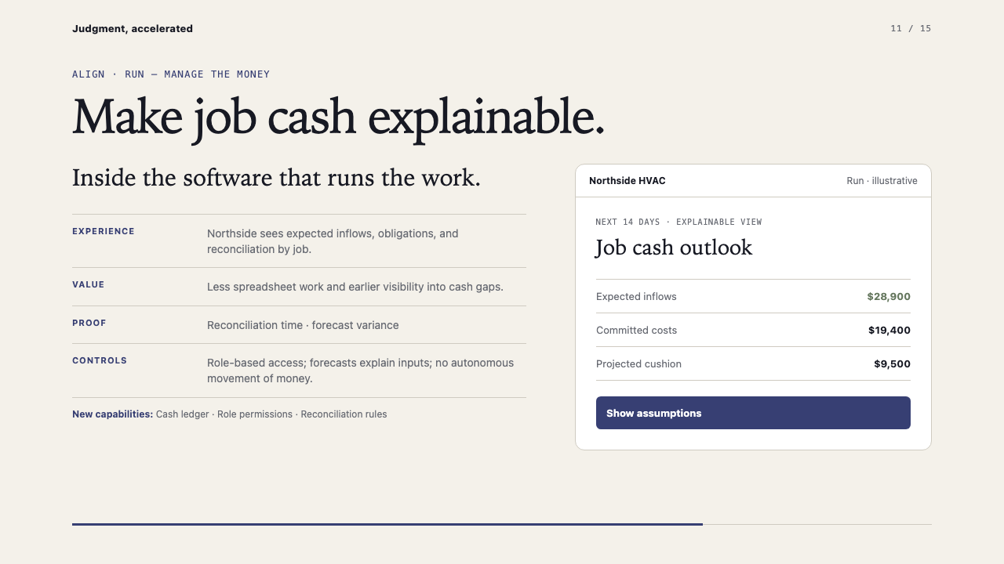
Notes:
Run makes job cash explainable without allowing autonomous movement of funds.
[Sources]
- Internal invented FieldFlow and Northside HVAC examples from the AI Demo package.

Slide 12
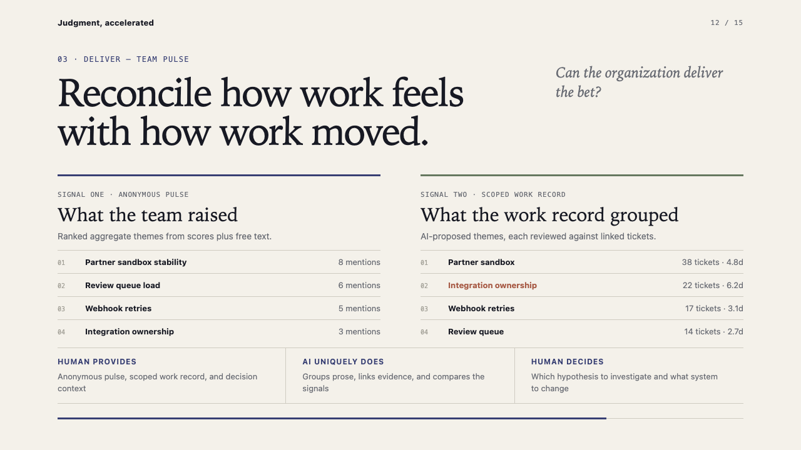
Notes:
The pulse and ticket data are synthetic. The useful move is comparing the two signals, not treating either as truth alone.
[Sources]
- Internal synthetic Team Atlas example from the AI Demo package.

Slide 13
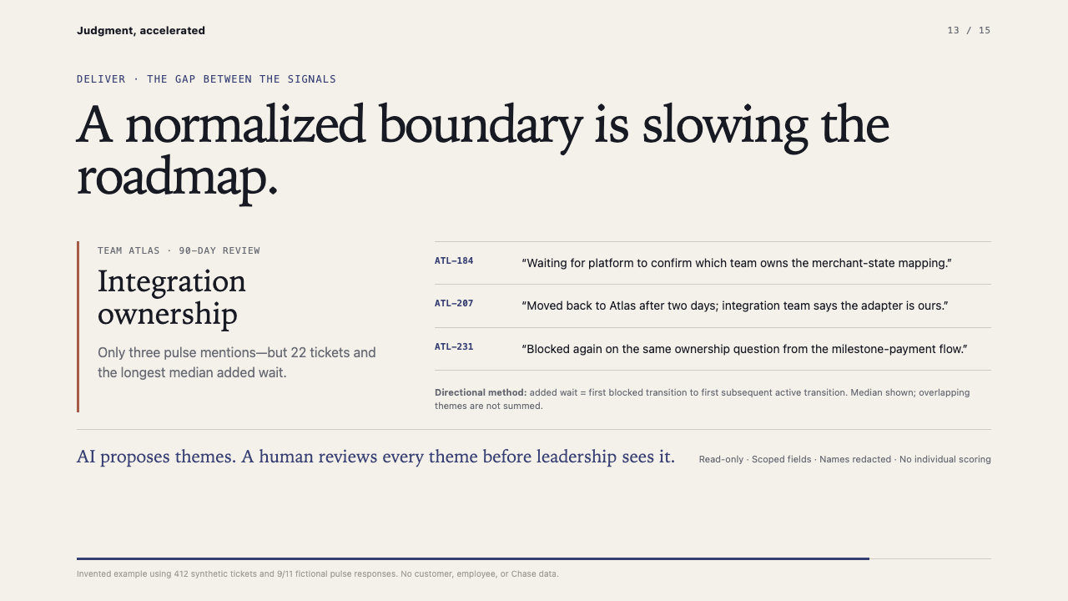
Notes:
The evidence supports a hypothesis about an ownership boundary. It does not score people or prove causality.
[Sources]
- Internal synthetic Team Atlas example from the AI Demo package.

Slide 14
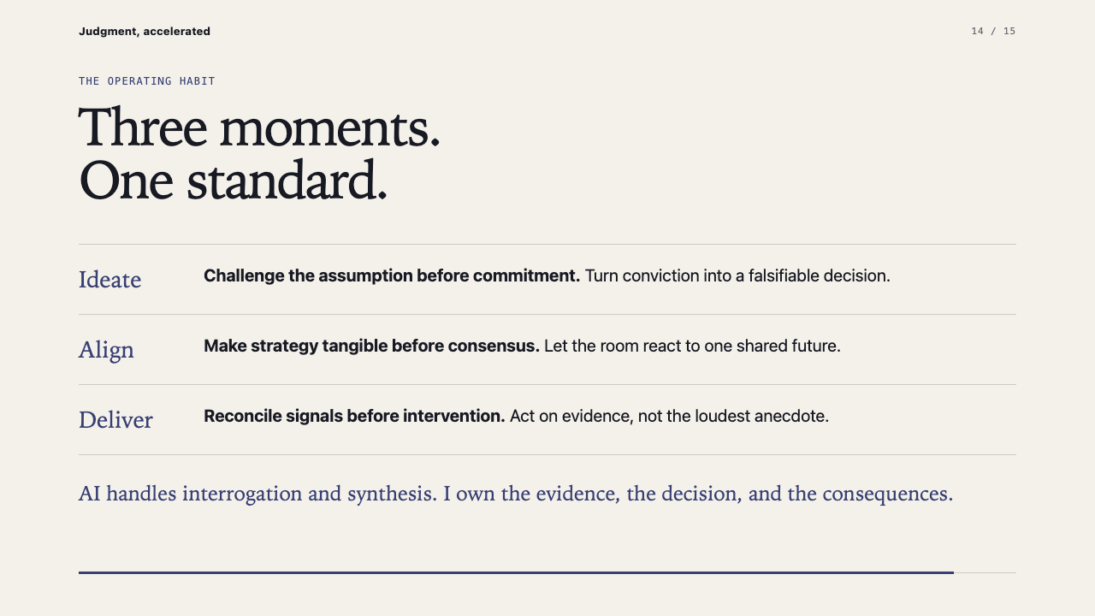
Notes:
Recap the leadership habit: challenge before commitment, make tangible before consensus, reconcile before intervention.
[Sources]
- Internal illustrative material from the AI Demo package.

Slide 15
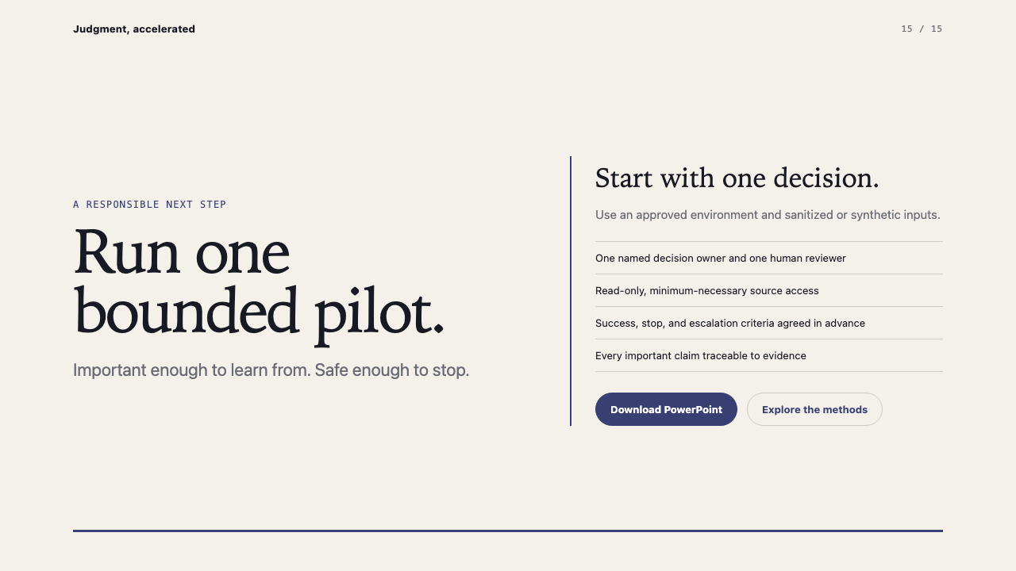
Notes:
End with a concrete, reversible next step inside approved tools and controls.
[Sources]
- Internal illustrative material from the AI Demo package.

